Slide 1
Recipe Site Traffic
by
Abdullahi Mujaheed Aliyu

Slide 2
Introduction
In this project, we explored the challenge of predicting recipe popularity with an 80% accuracy rate while minimizing the display of unpopular recipes.
A 947 rowed structured dataset with seven columns, contains comprehensive nutritional information such as the number of calories, carbohydrates, sugars, and proteins each recipe contains was analyzed and used to developed a classification machine learning model.
Other columns were the servings, which contains the number of distinct times the food can be served. The category contains the possible label that can be attributed to the recipe, amongst them were meat,chicken breast, breakfast, beverage etc. Lastly is another column with text ‘high’ when a particular recipe generates high traffic on the website.

Slide 3
Aims
Explore and predict which recipes will lead to high traffic
Correctly predict high traffic recipes 80% of the time

Slide 4
Data Validation
recipe: No missing value, sequential integers. column used for recipe indexing only.
calories: 52 null values, floating point numeric data, rightly skewed, imputed with the median. Feature was scaled before fitting into models.
carbohydrate: same operation as the calories feature.
sugar: same operation as the calories feature.
protein: same operation as the calories feature.
category: non null categorical feature. Chicken breast observations were replaced with chicken as directed in the data dictionary for validation. Feature was transformed to numeric values for the classification model development using the onehot encoding.
serving: non null, numeric data originally but posessing the object datatype. the datatype was transformed to integer.
high_traffic: 373 null were inputed as 'low' as described in the data. Target value of classification model, Target features was transformed by the ordinal encoder into numeric integer as required by the classification models

Slide 5
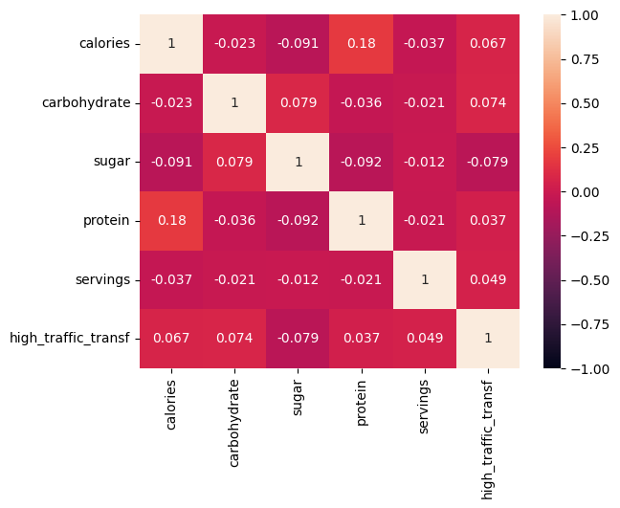
Exploratory Data Analysis
From the correlation heatmap below, it is obvious that the nutrient features and number of servings of a recipe do not affects its traffic on the website.

Slide 6
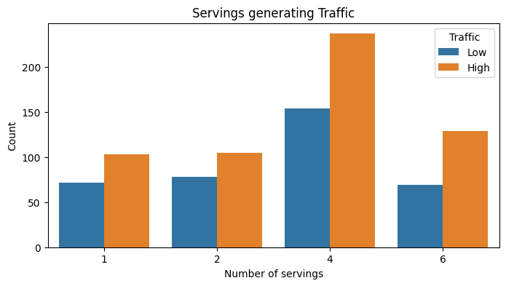
Exploratory Data Analysis
From the countplot below, we can conclude that the recipe with servings of 4 were mostly uploaded, over 40% the entire time. Simultaneously, the servings of 4 generated more traffic distinctly.

Slide 7
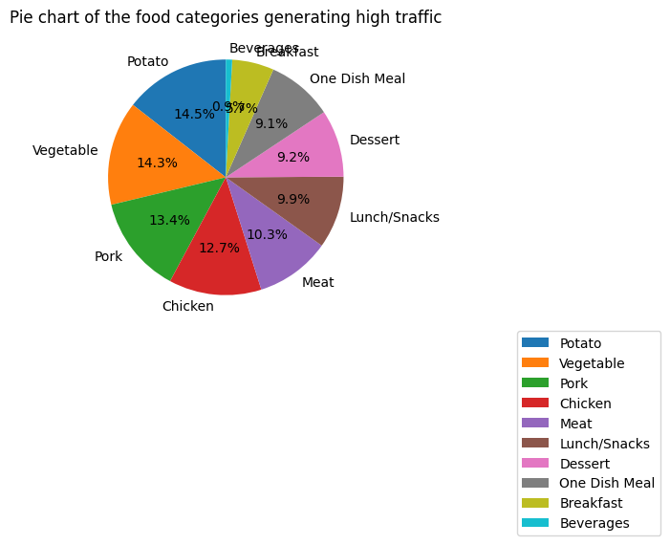
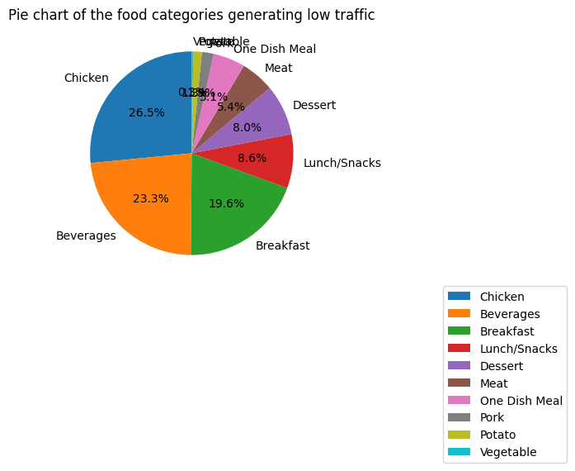
Exploratory Data Analysis
From the pie charts, the food categories generating the traffic are potato, vegetable, pork and chicken totalling over 50% of the total traffic. Meanwhile chicken, beverages, breakfast and Lunch/snacks are associated with the low traffic, accounting for almost 75% of the low traffic the entire time.

Slide 8
Model Development
This task classification task. It means predicting an outcome out of 2 or more possible outcomes. To predict if a recipe will generate traffic or not, on the website.
The logistic regression will be employed as the base model.
The random forest classifier will be used as the alternative model for comparison

Slide 9
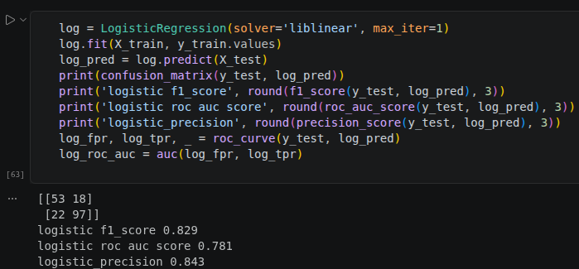
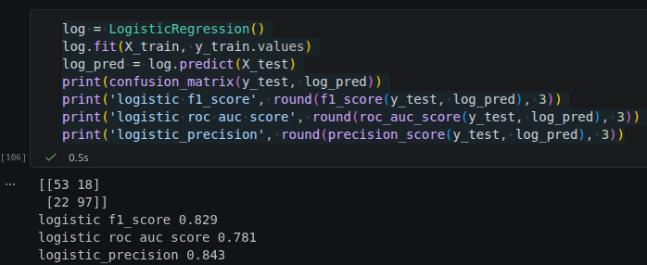
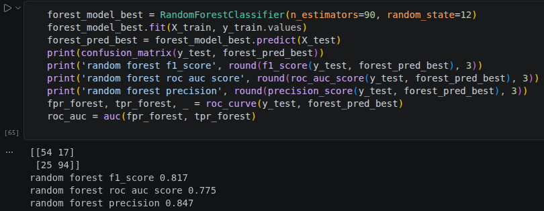
Model Evaluation
F1 score, precision, auc

Slide 10
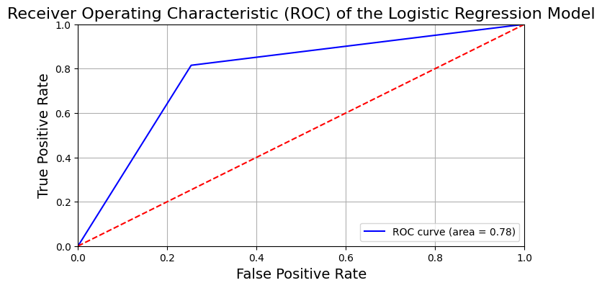
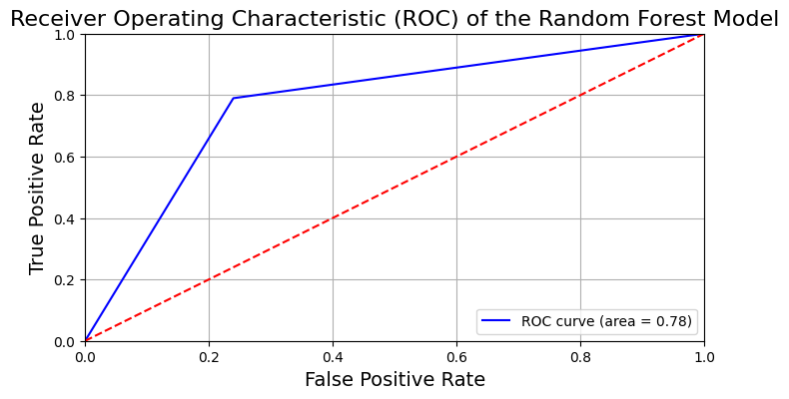
Model Evaluation
The Logistic Regression outperforms the Random Forest Classifier on f1 score and roc_auc scores, while the random forest classifier has better precision metric. Most notably, the ROC-AUC curve score of both models is 0.78 indicating that both models have good discriminative ability, distinguishing between high and low traffic generating recipes.

Slide 11
Business Metric
- The product team's primary goal is to "predict which recipes will lead to high traffic also minimize the chance of showing unpopular recipes." This emphasis on avoiding unpopular recipe recommendations aligns with Precision as the key metric. Recipes leading to high traffic are true positives while unpopular recipes classified as popular is a case of false positives, both which constitutes the precision score.- The final precision score of 84.7% of the prediction while the initial high traffic of the original data 59.8%, meaning about 41% improvement and about 6% more than the desired precision from the product team.

Slide 12
Final Summary and Recommendation
Although 80% precision was requested, the model delivers 84.7% precision, a significant 41% improvement over manual selection. This eliminates guesswork and provides data-driven recommendations.
I recommend the deployment of the random forest regressor model while adhering to monitoring during and after the deployment.
I recommend collection of additional data for the accomodation of more sophisticated model without the fear of overfitting.

